Slide 1

Deep Learning Crash Course
Hui Xue
Fall 2021
www.deeplearningcrashcourse.org

Slide 2
Outline
Transfer learning
Meta Learning
Contrastive learning

Slide 3
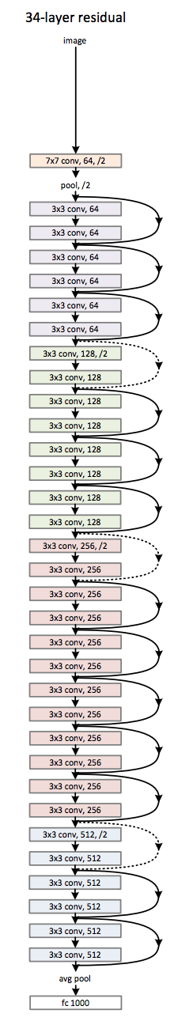
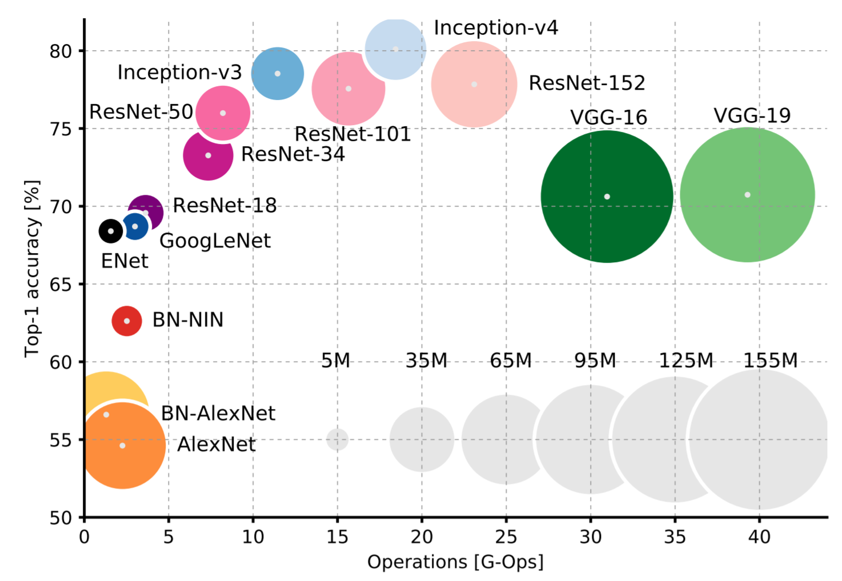
Motivation for “Not” train a whole network
ResNet 34 architecture
Convenient to use an existing architecture
Time and cost to train a large network
Limited data for a specific task
3.6 billion FLOPs
Takes ~2weeks to train on ImageNet dataset
on single GPU
(ImageNet-1K, single Nvidia M40 GPU)
Deep Residual Learning for Image Recognition. https://arxiv.org/abs/1512.03385
An Analysis of Deep Neural Network Models for Practical Applications. https://arxiv.org/abs/1605.07678

Slide 4
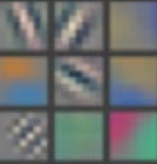
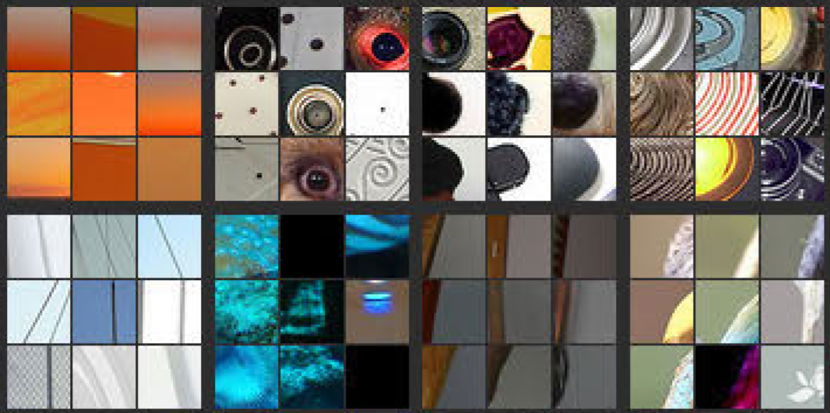
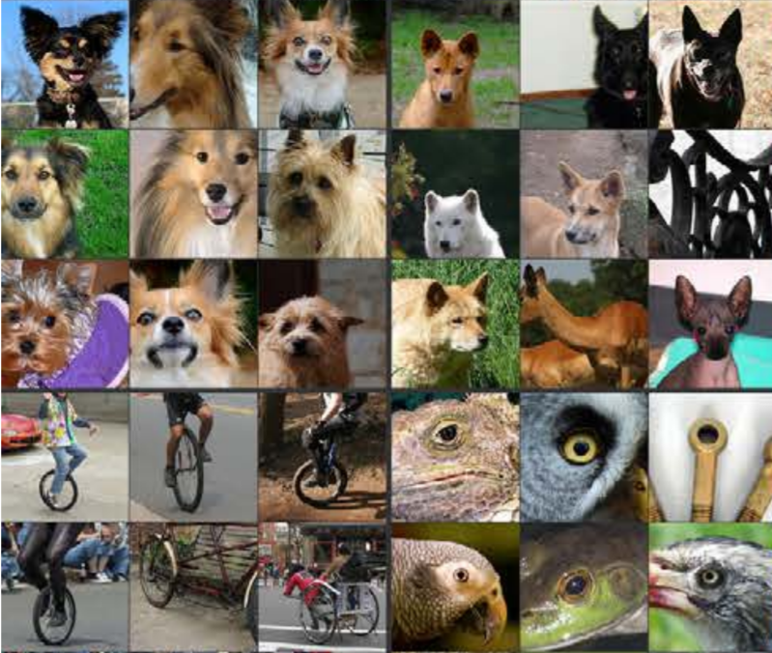
Transfer learning as feature extractor
… …
Deep Residual Learning for Image Recognition. https://arxiv.org/abs/1512.03385
Visualizing and Understanding Convolutional Networks. https://arxiv.org/abs/1311.2901

Slide 5
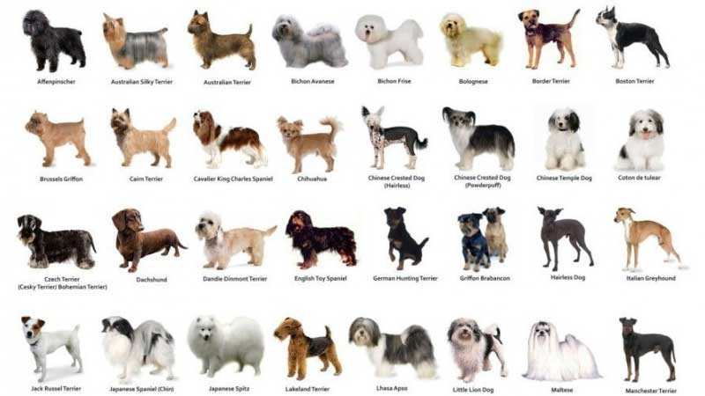
Transfer learning as feature extractor
Freeze the weights
Reinitialize and train
Data for new task is not abundant, e.g. 5K images
Data is similar to common dataset, e.g. a set of different dog breeds
You are happy with classical architecture – often favoring classification problems
Deep Residual Learning for Image Recognition. https://arxiv.org/abs/1512.03385
https://miro.medium.com/max/1200/1*DWUdYY4ZX6AAAIgyK3LCsQ.jpeg

Slide 6
Transfer learning variations
Freeze the weights
Reinitialize and train
There are more data for the new task, e.g. 10K images
Task specific data is like common dataset
Happy with existing architecture – often for classification problems
Need to treat the number of re-trained layers as a hyperparameter
Deep Residual Learning for Image Recognition. https://arxiv.org/abs/1512.03385

Slide 7
Fine-tuning
Earlier model has local skip connections
Still maintain a feed-forward architecture
Focus more on classification
Deep Residual Learning for Image Recognition. https://arxiv.org/abs/1512.03385
Fine tuning
Optimize all model weights
Reduce learning rate
Train less epochs/early stopping if task specific dataset is small
Test set only includes the task specific data
https://arxiv.org/abs/2008.06142

Slide 8
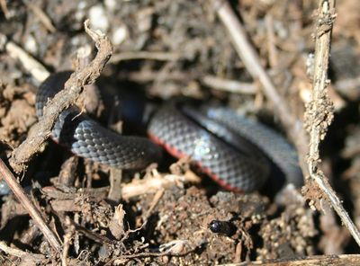
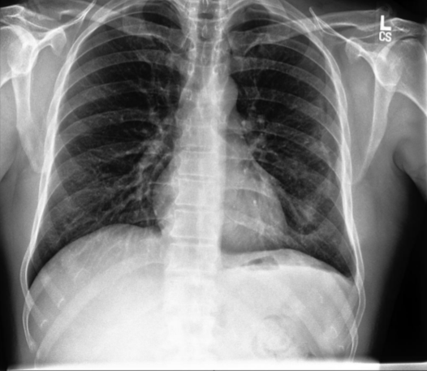
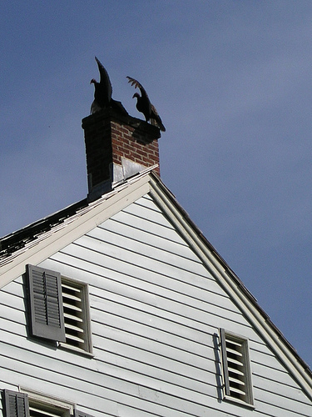
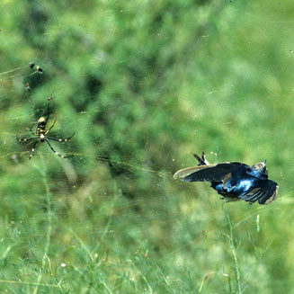
Difference in data distribution
CheXpert dataset consisting of 224,316 chest X-rays of 65,240 patients - https://stanfordmlgroup.github.io/competitions/chexpert/

Slide 9
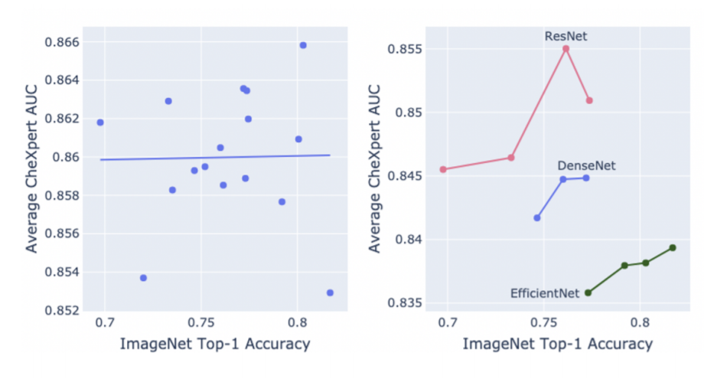
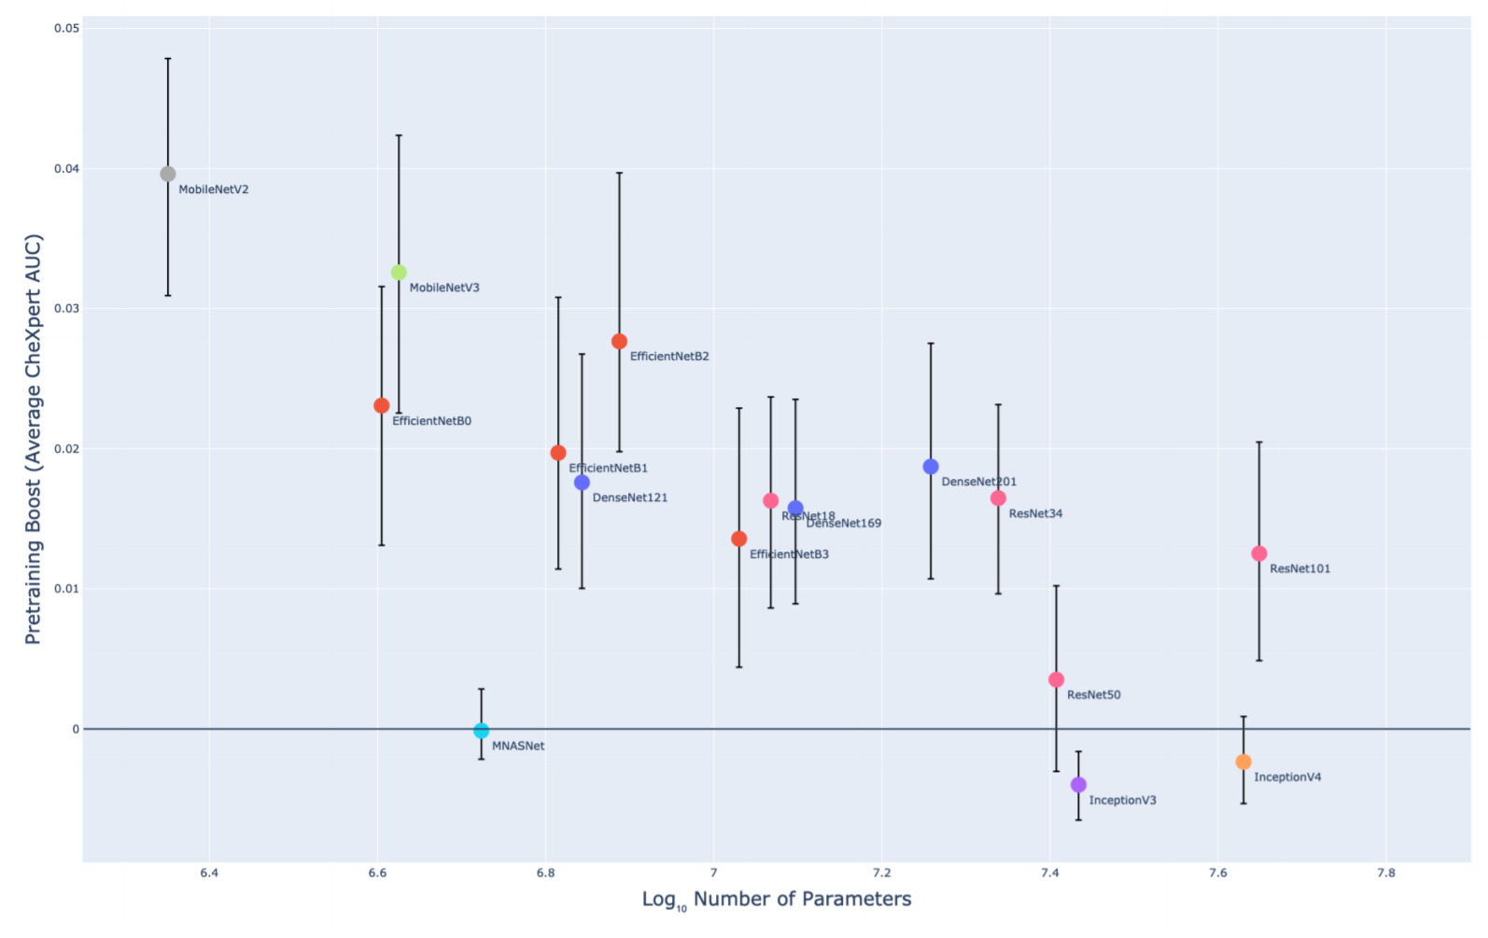
Pre-trained model may not always give large gain
Use ImageNet-1K dataset to pretrain 16 different CNN models
Transfer learning per-trained model on Chest X-ray dataset
No correlation between chest X-ray performance with Image-Net performance …
More impact on performance is from model architecture family (e.g. ResNet vs. DenseNet), than model size within one family (e.g. ResNet 34 vs. ResNet 50)
Pre-training gave more performance boost for smaller model
Fine-tuning was used
CheXpert dataset consisting of 224,316 chest X-rays of 65,240 patients - https://stanfordmlgroup.github.io/competitions/chexpert/
CheXtransfer: Performance and Parameter Efficiency of ImageNet Models for Chest X-Ray Interpretation. 2021. https://arxiv.org/abs/2101.06871

Slide 10
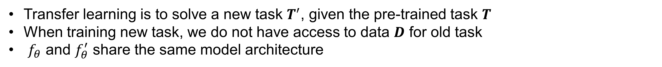
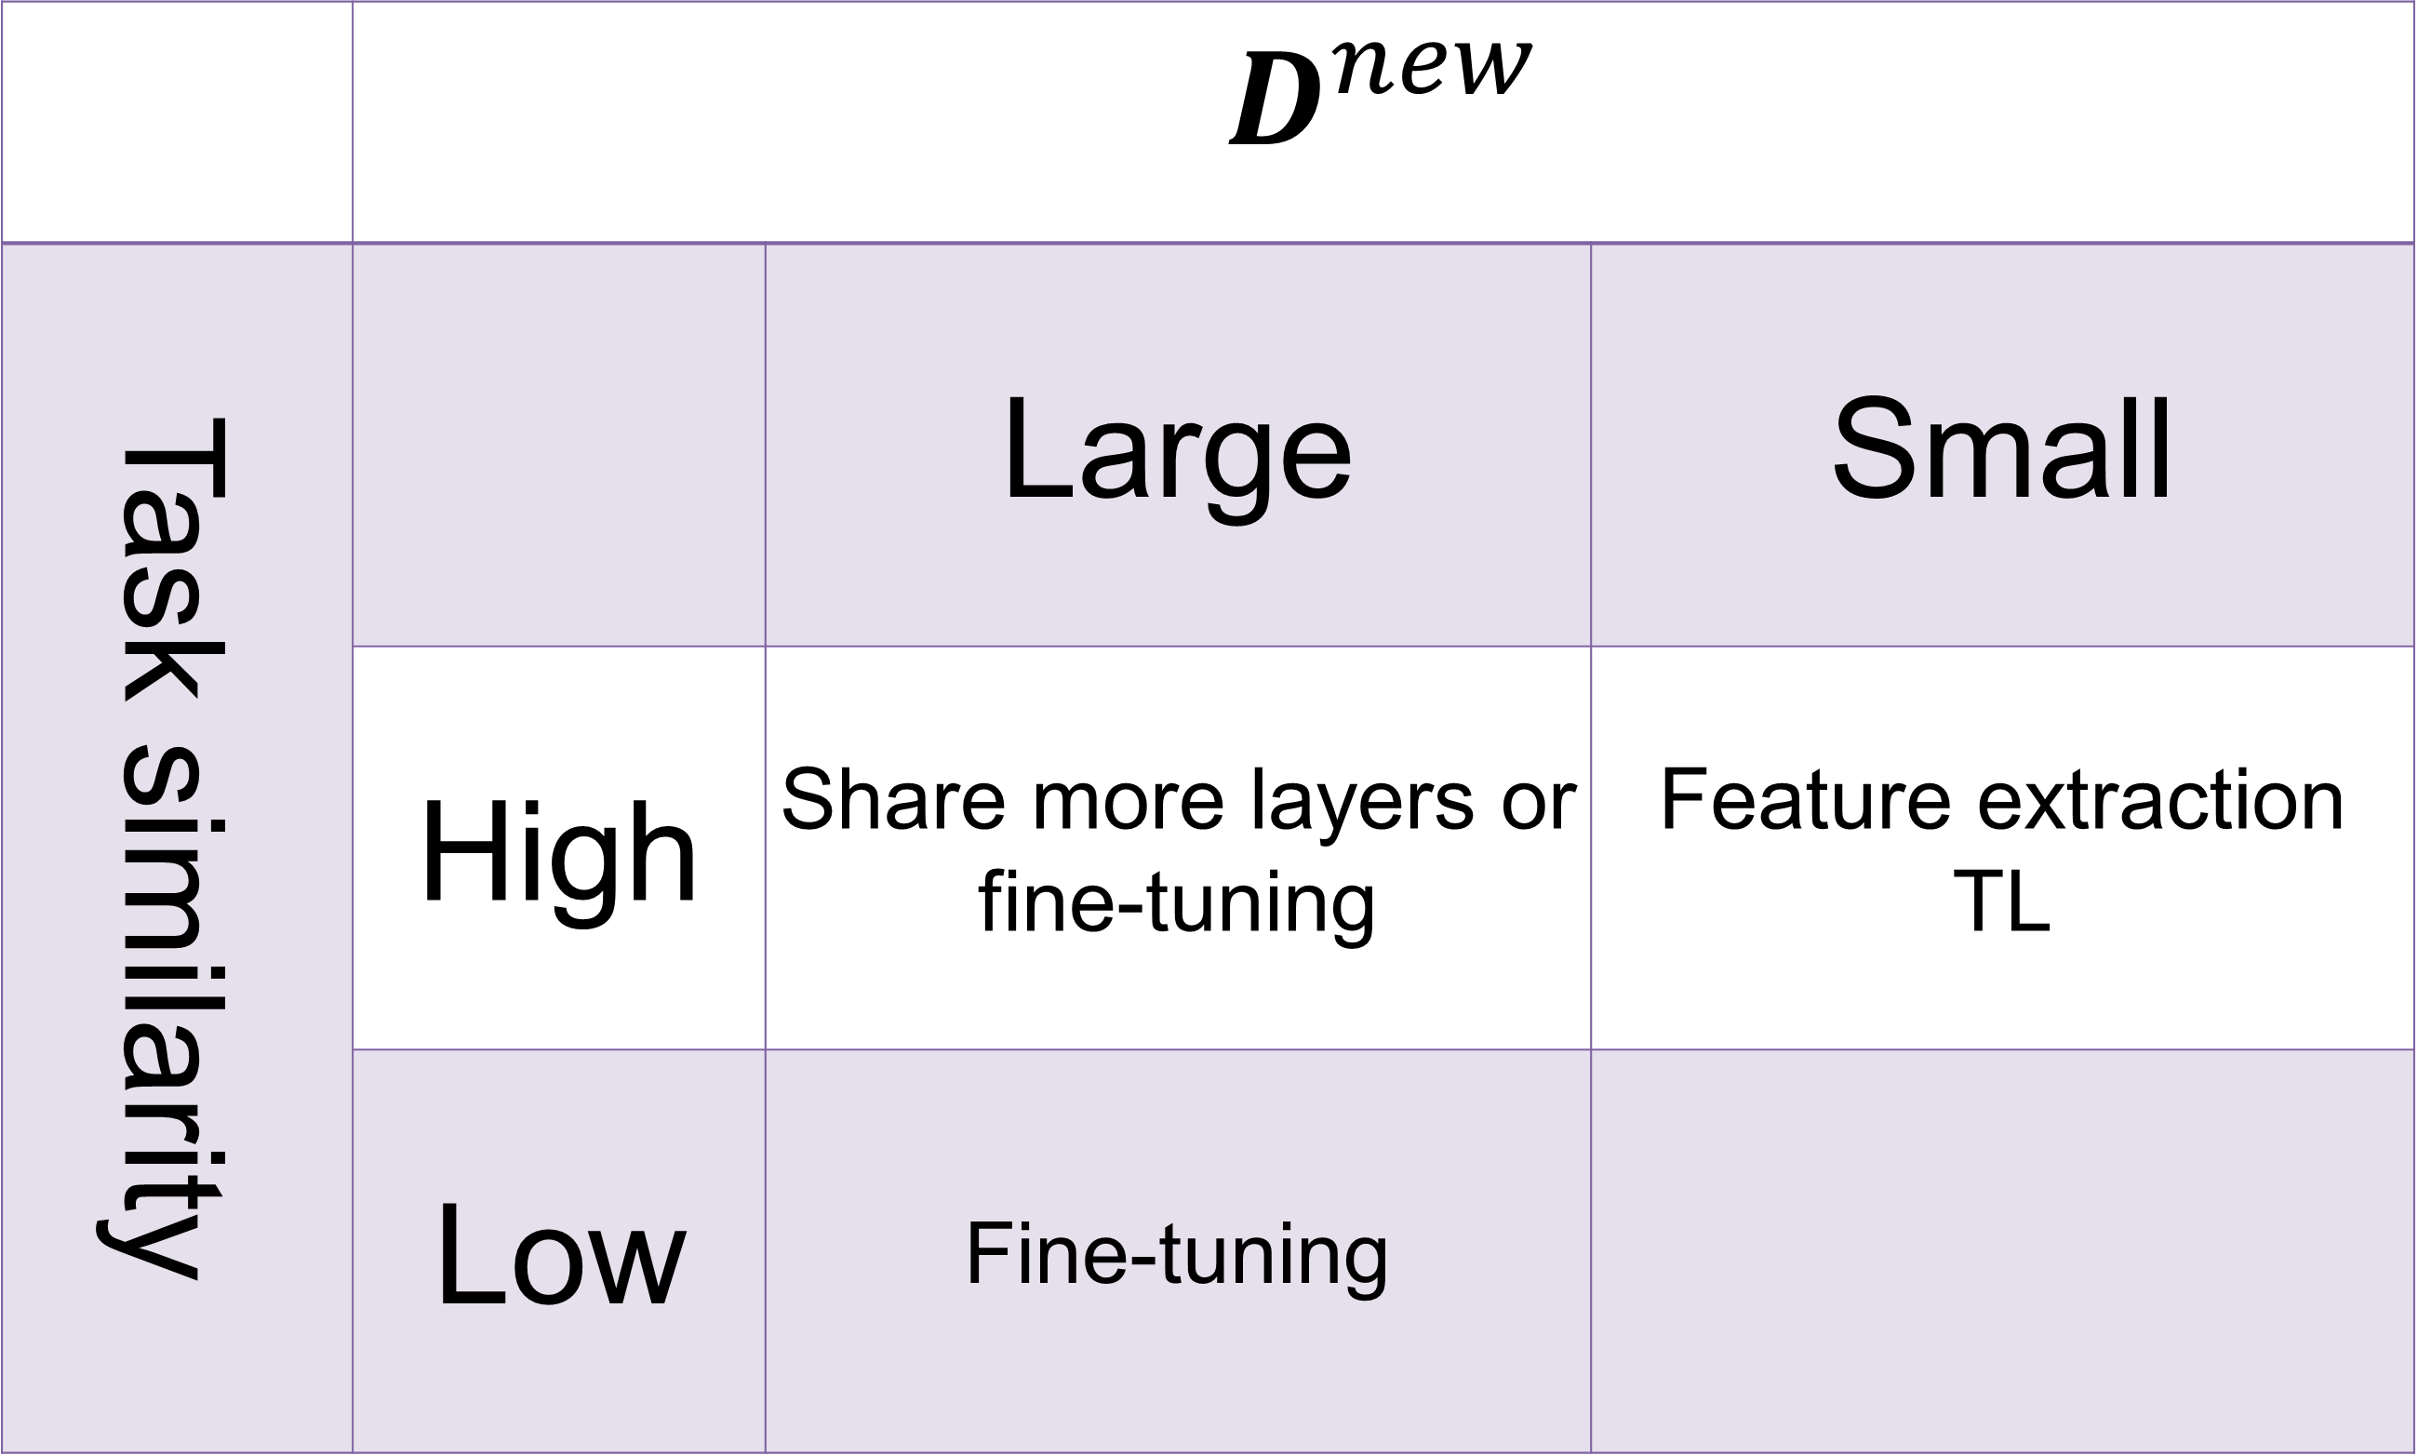
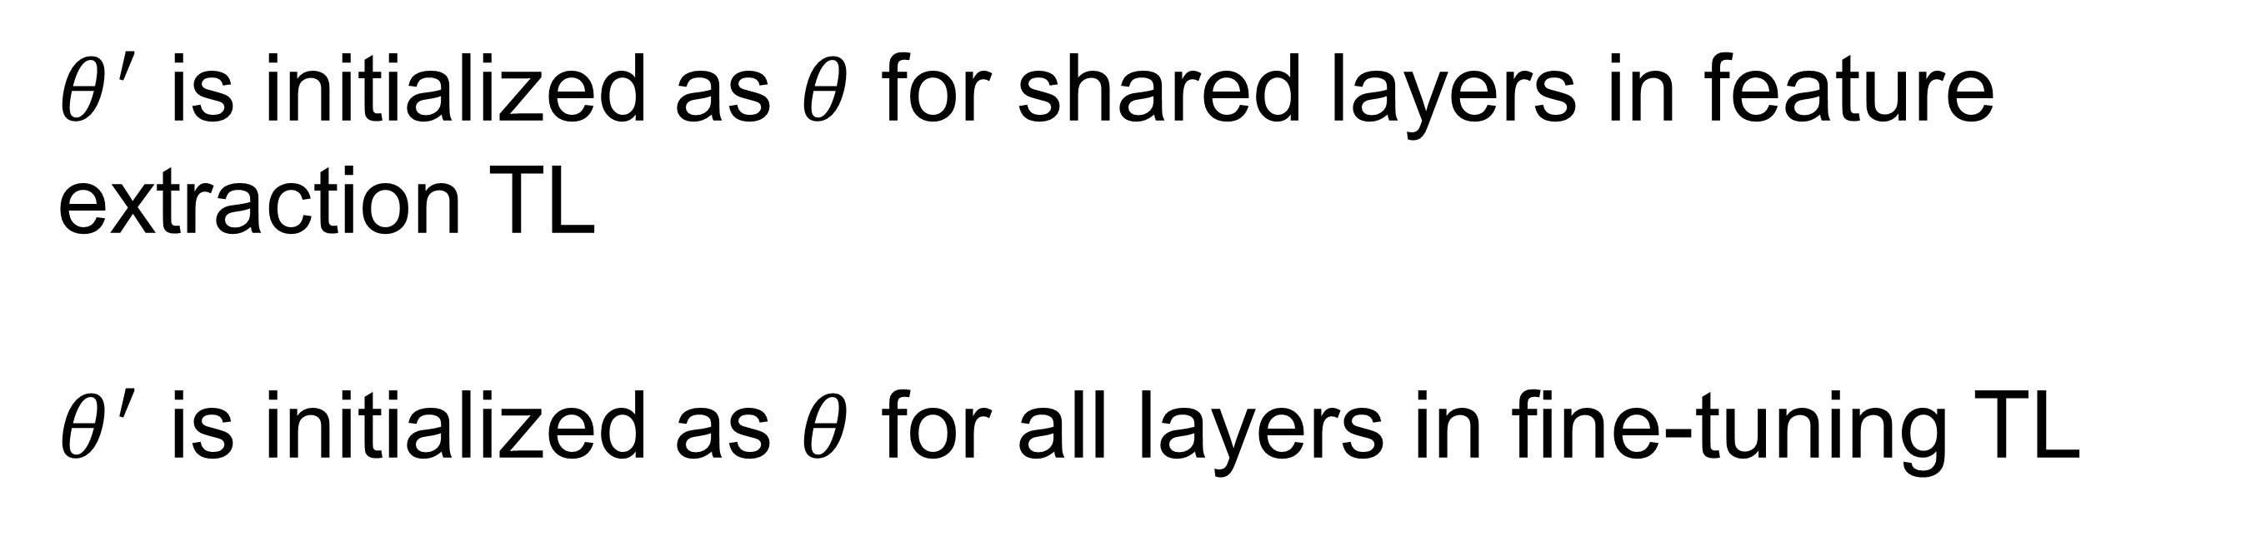
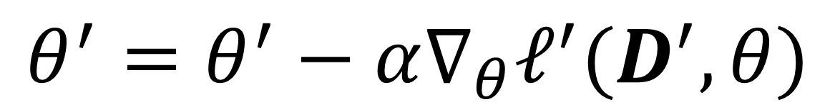
Transfer learning
Define the task as : data set $D$, loss function $ℓ$, model with parameter $f_{θ}$, task $Τ=\{D,ℓ,f_{θ}\}$
Transfer learning is to solve a new task $Τ^{′}$, given the pre-trained task $Τ$
When training new task, we do not have access to data $D$ for old task
$f_{θ}$ and $f_{θ}^{′}$ share the same model architecture
 | $$D^{new}$$
Task similarity |  | Large | Small
 | High | Share more layers or fine-tuning | Feature extraction TL
 | Low | Fine-tuning
$$θ^{′}=θ^{′}−α∇_{θ}ℓ^{′}(D^{′},θ)$$
$θ^{′}$ is initialized as $θ$ for shared layers in feature extraction TL
$θ^{′}$ is initialized as $θ$ for all layers in fine-tuning TL
Need bigger gun …

Slide 11
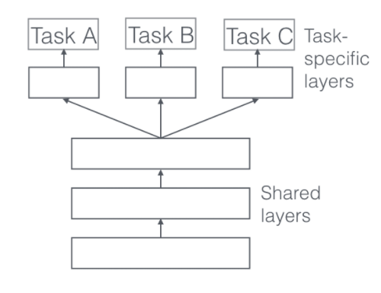
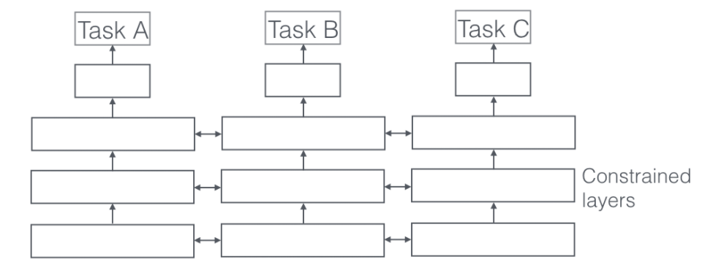
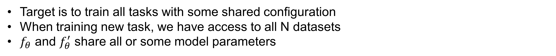
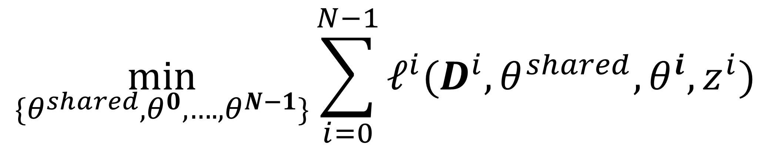
Multi-task learning
There are a set of tasks : $T_{i}={\{D,ℓ,f_{θ}\}}_{i}, i=0,…, N−1$
Target is to train all tasks with some shared configuration
When training new task, we have access to all N datasets
$f_{θ}$ and $f_{θ}^{′}$ share all or some model parameters
$$\min_{{\{θ}^{shared},θ^{0},….,θ^{N−1}\}}{\sum_{i=0}^{N−1}{ℓ^{i}(D^{i},θ^{shared},θ^{i},z^{i})}}$$
$z^{i}$ is task specifier, e.g. one-hot vector for tasks
Reduce risk of overfitting
Learn more general representation from multiple tasks
Need to balance sampling for tasks for training
Need to balance loss across tasks for training
Transfer learning is a sequential way to solve multi-task learning
https://ruder.io/multi-task/

Slide 12
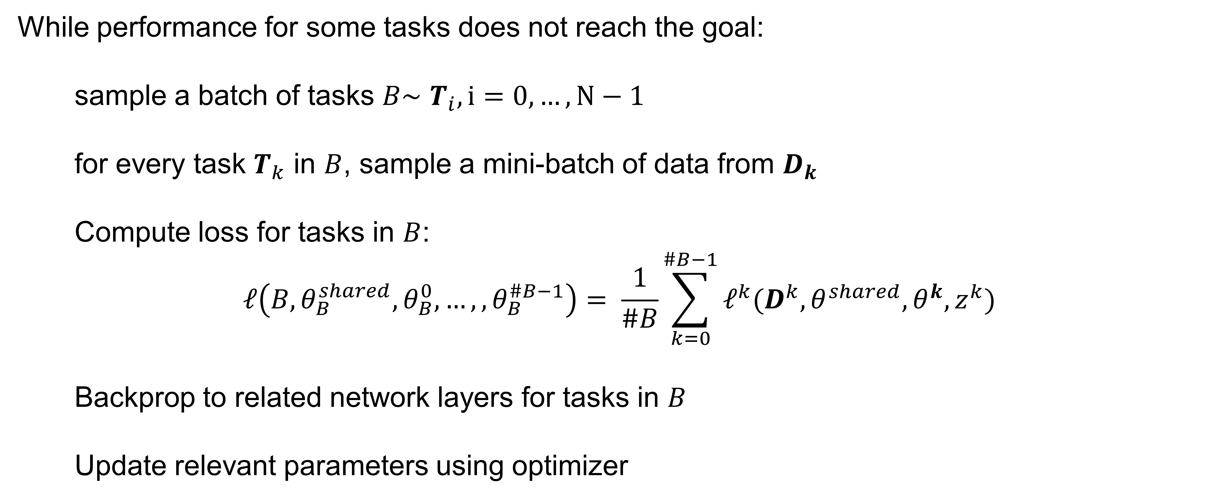
Multi-task learning
There are a set of tasks : $T_{i}={\{D,ℓ,f_{θ}\}}_{i}, i=0,…, N−1$
While performance for some tasks does not reach the goal:
sample a batch of tasks $B\sim$ $T_{i}, i=0, …, N−1$
for every task $T_{k}$ in $B$, sample a mini-batch of data from $D_{k}$
Compute loss for tasks in $B$:
$$ℓ\left(B,θ_{B}^{shared},θ_{B}^{0},…,,θ_{B}^{\#B−1}\right)= \frac{1}{\#B}\sum_{k=0}^{\#B−1}{ℓ^{k}(D^{k},θ^{shared},θ^{k},z^{k})}$$
Backprop to related network layers for tasks in $B$
Update relevant parameters using optimizer
Need a task
sampling strategy
Need to balance
loss across tasks

Slide 13
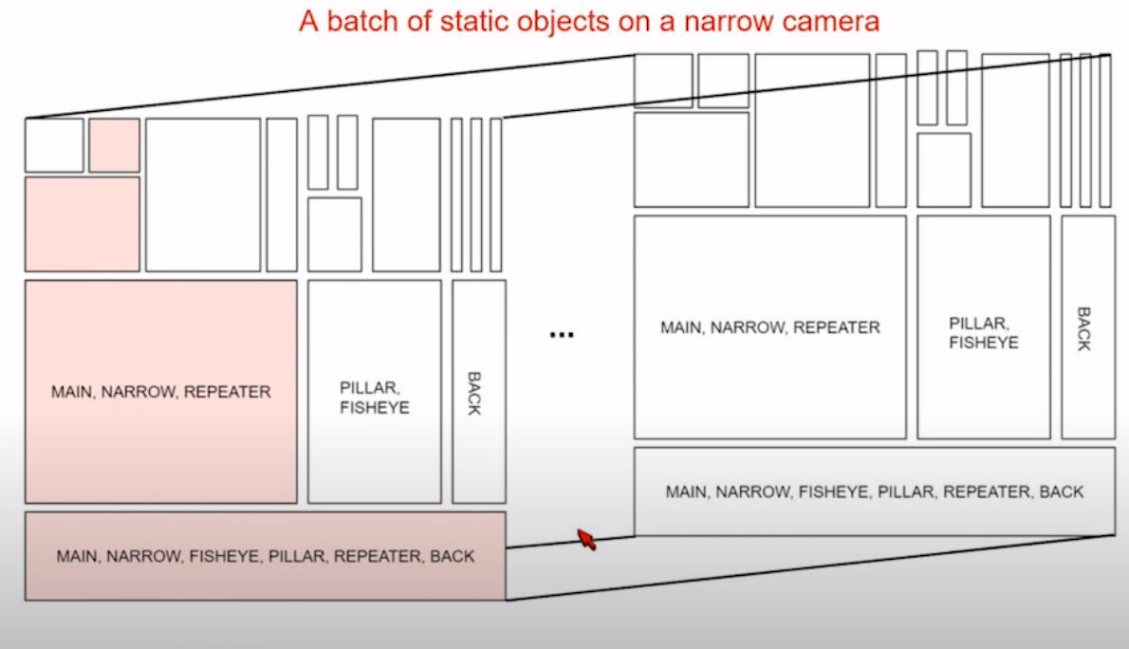
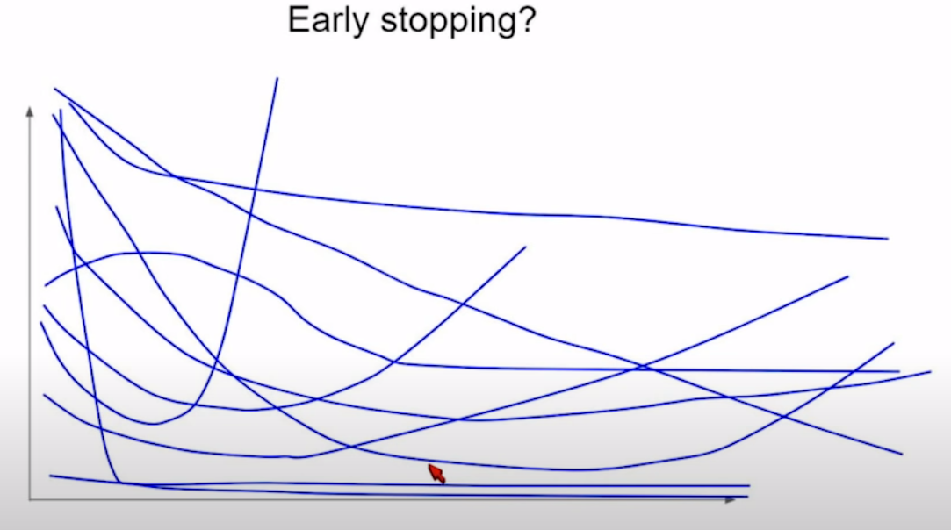
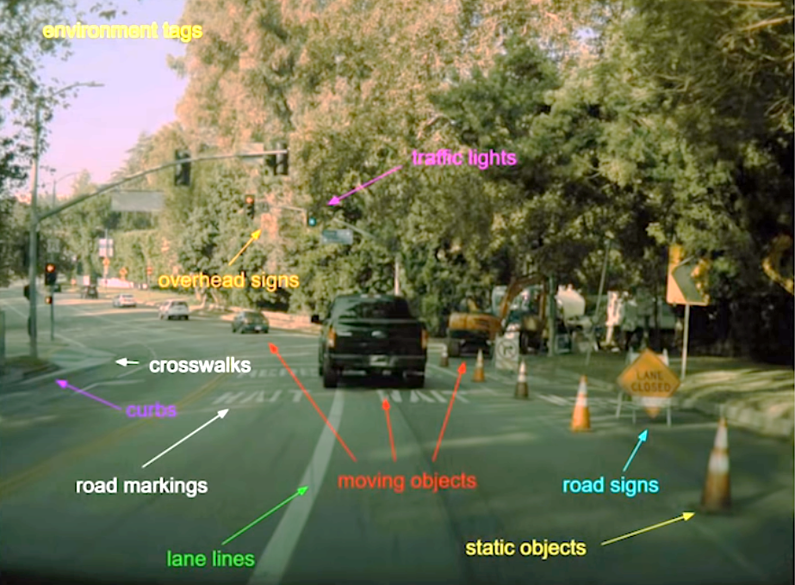
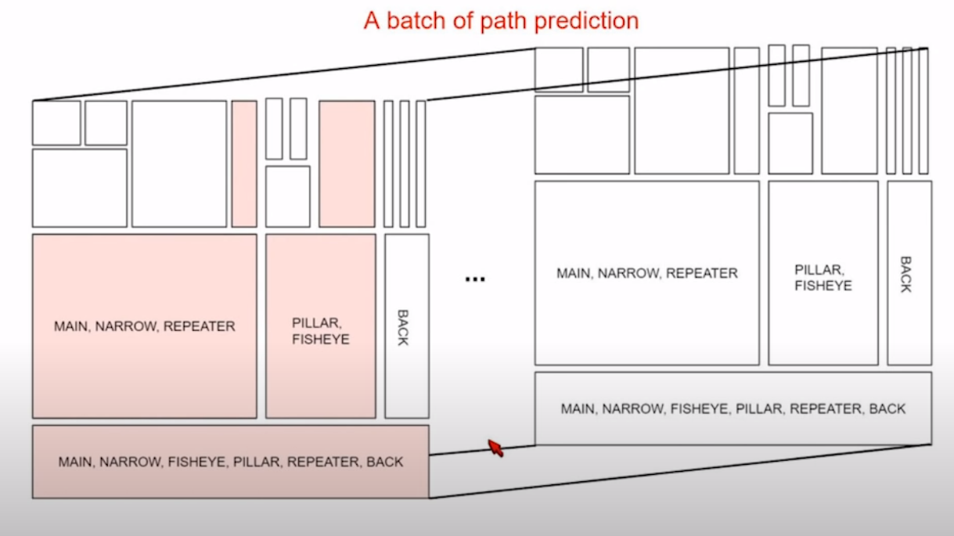
Multi-task learning in Tesla
Loss for tasks
epochs
Andrej Karpathy: Tesla Autopilot and Multi-Task Learning for Perception and Prediction

Slide 14
Outline
Transfer learning
Meta Learning
Contrastive learning

Slide 15
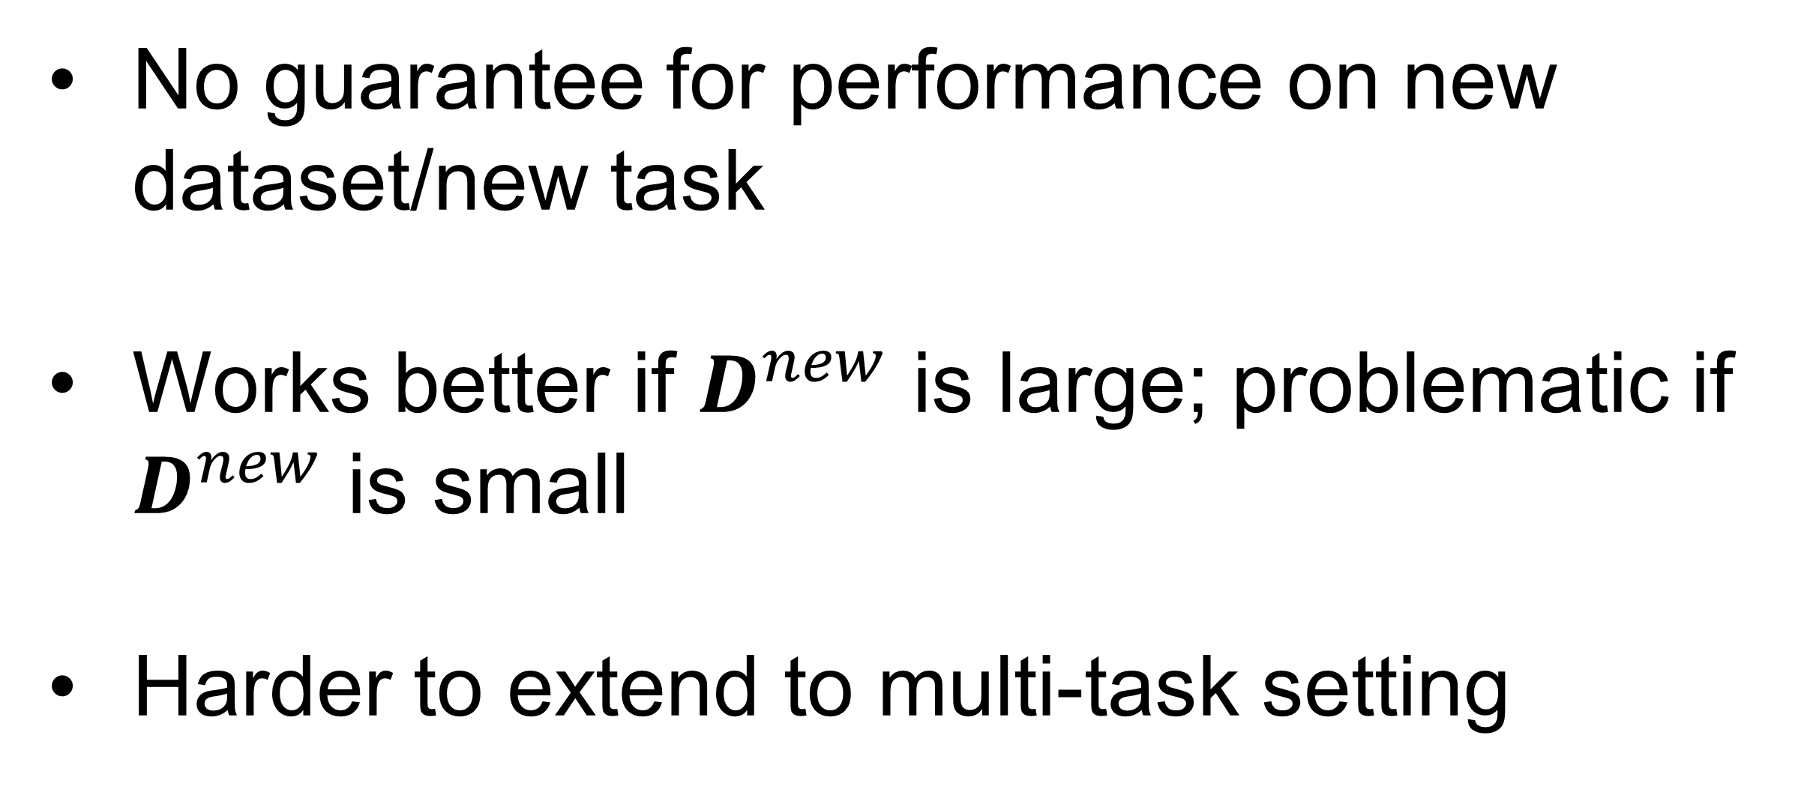
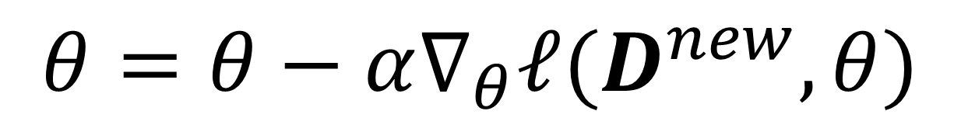
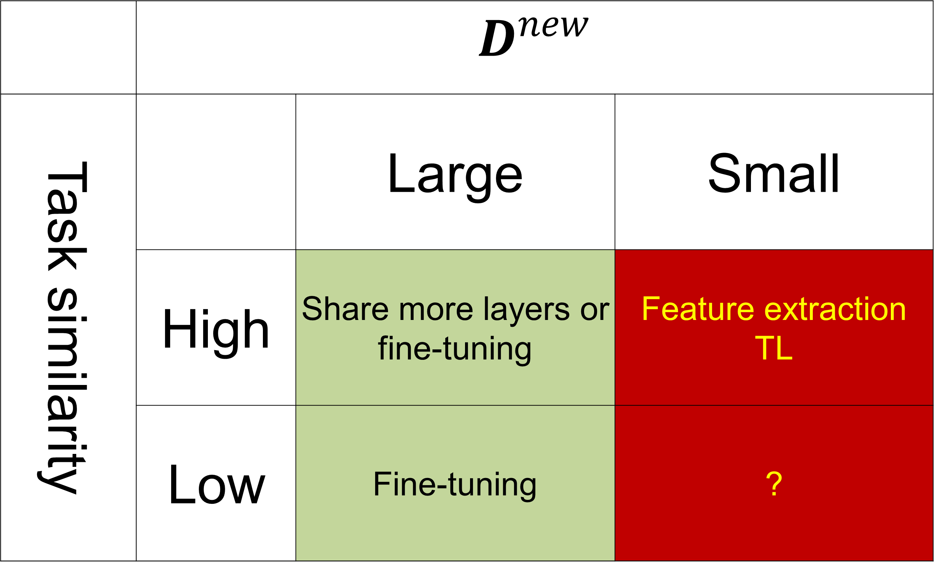
Motivation for meta learning
Define the task as : data set $D$, loss function $ℓ$, model with parameter $f_{θ}$, task $Τ=\{D,ℓ,f_{θ}\}$
Transfer learning: initialize parameters from pre-trained model, continue training on new dataset
 | $$D^{new}$$
Task similarity |  | Large | Small
 | High | Share more layers or fine-tuning | Feature extraction TL
 | Low | Fine-tuning | ?
$$θ=θ−α∇_{θ}ℓ(D^{new},θ)$$
No guarantee for performance on new dataset/new task
Works better if $D^{new}$ is large; problematic if $D^{new}$ is small
Harder to extend to multi-task setting

Slide 16
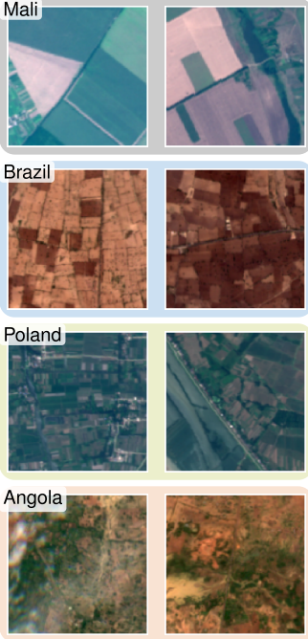
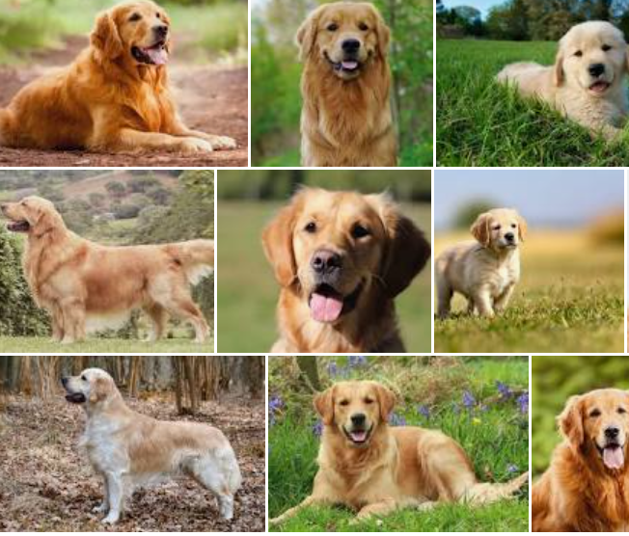
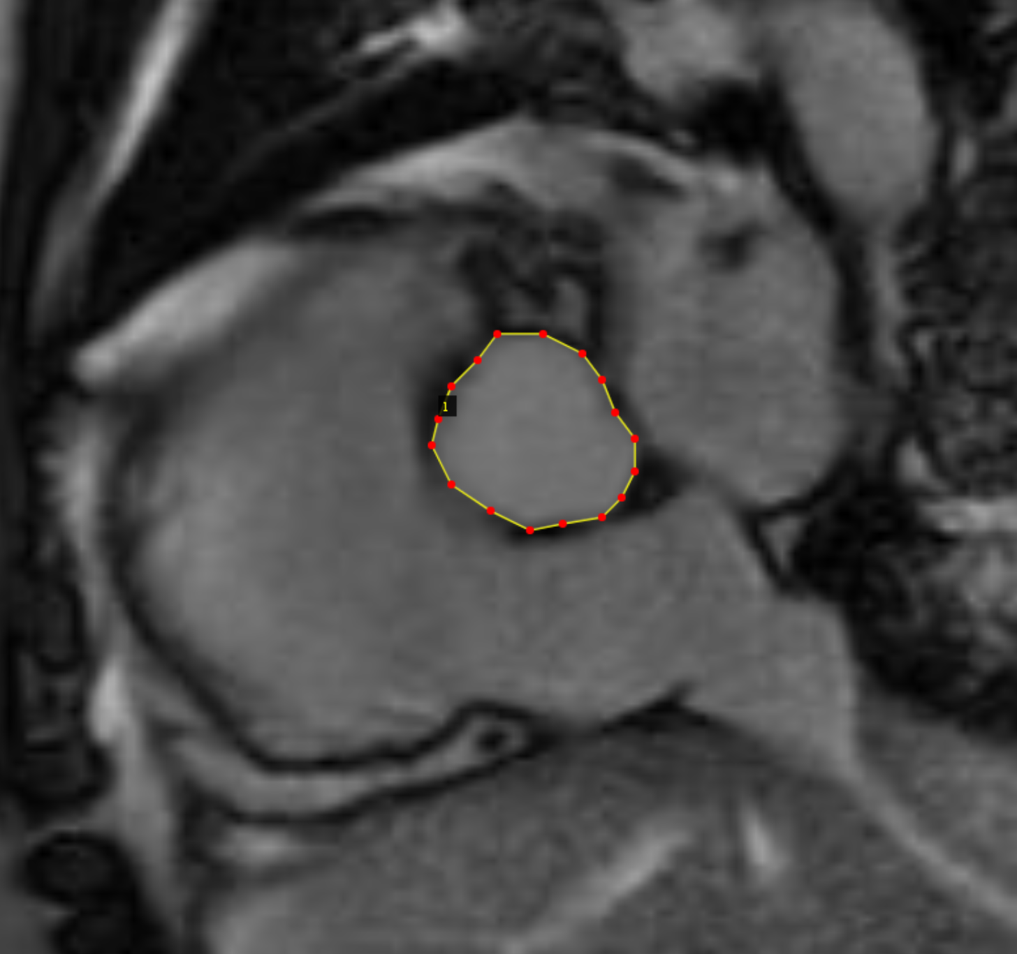
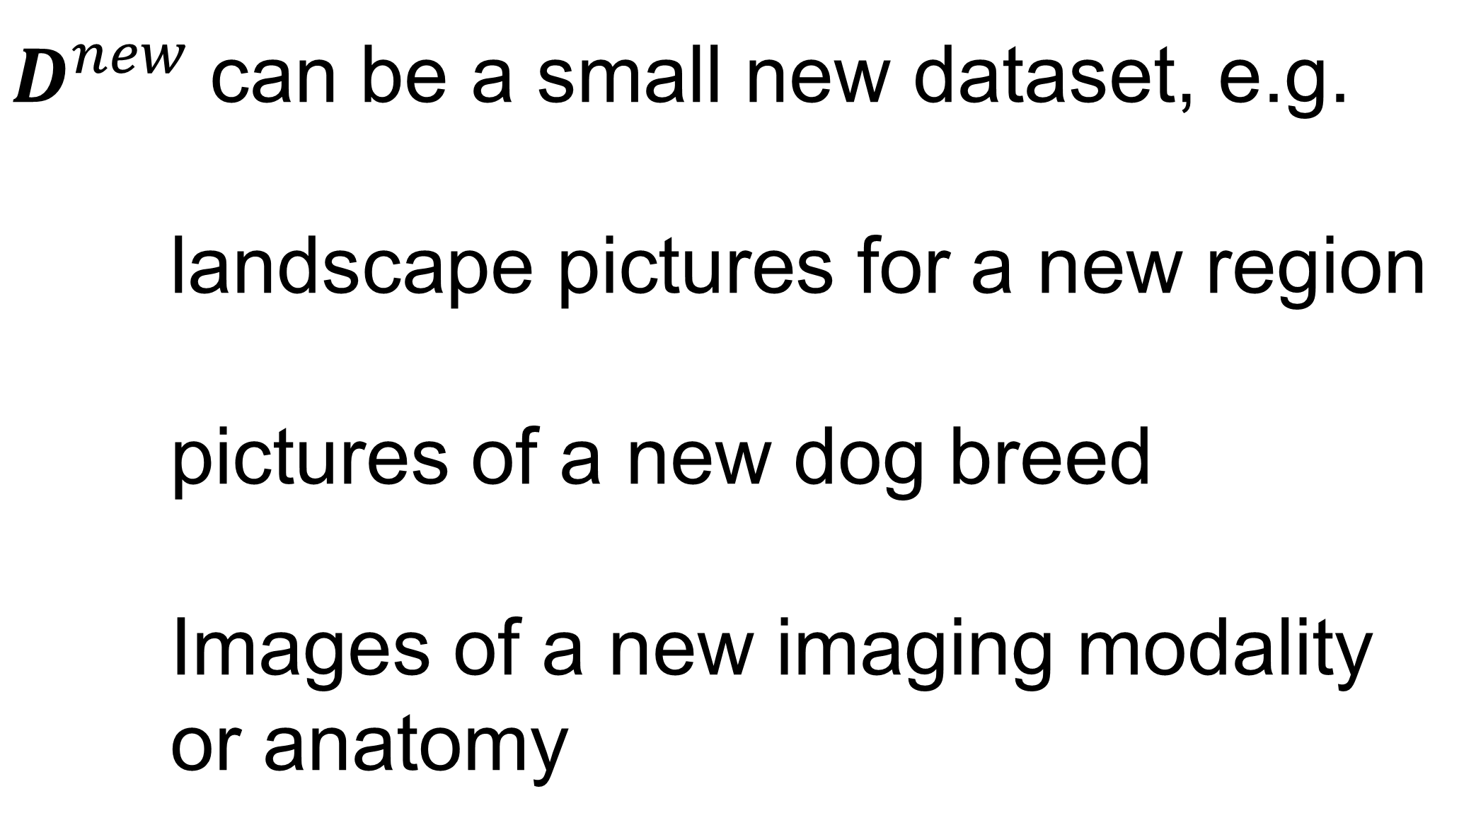
Model Agnostic Meta Learning (MAML)
Define the task as : data set $D$, loss function $ℓ$, model with parameter $f_{θ}$, task $Τ=\{D,ℓ,f_{θ}\}$
Given a set of tasks $T_{i}={\{D,ℓ,f_{θ}\}}_{i}, i=0,…, N−1$, can we solve a new task $T^{new}=\{D^{new},ℓ,f_{θ}\}$
$D^{new}$can be a small new dataset, e.g.
landscape pictures for a new region
pictures of a new dog breed
Images of a new imaging modality
or anatomy
Aorta vessel
What we want:
Given a model and a set of related task, quickly learn on new dataset, quickly gain new ability
Meta-Learning for Few-Shot Land Cover Classification. 2020. https://arxiv.org/abs/2004.13390

Slide 17
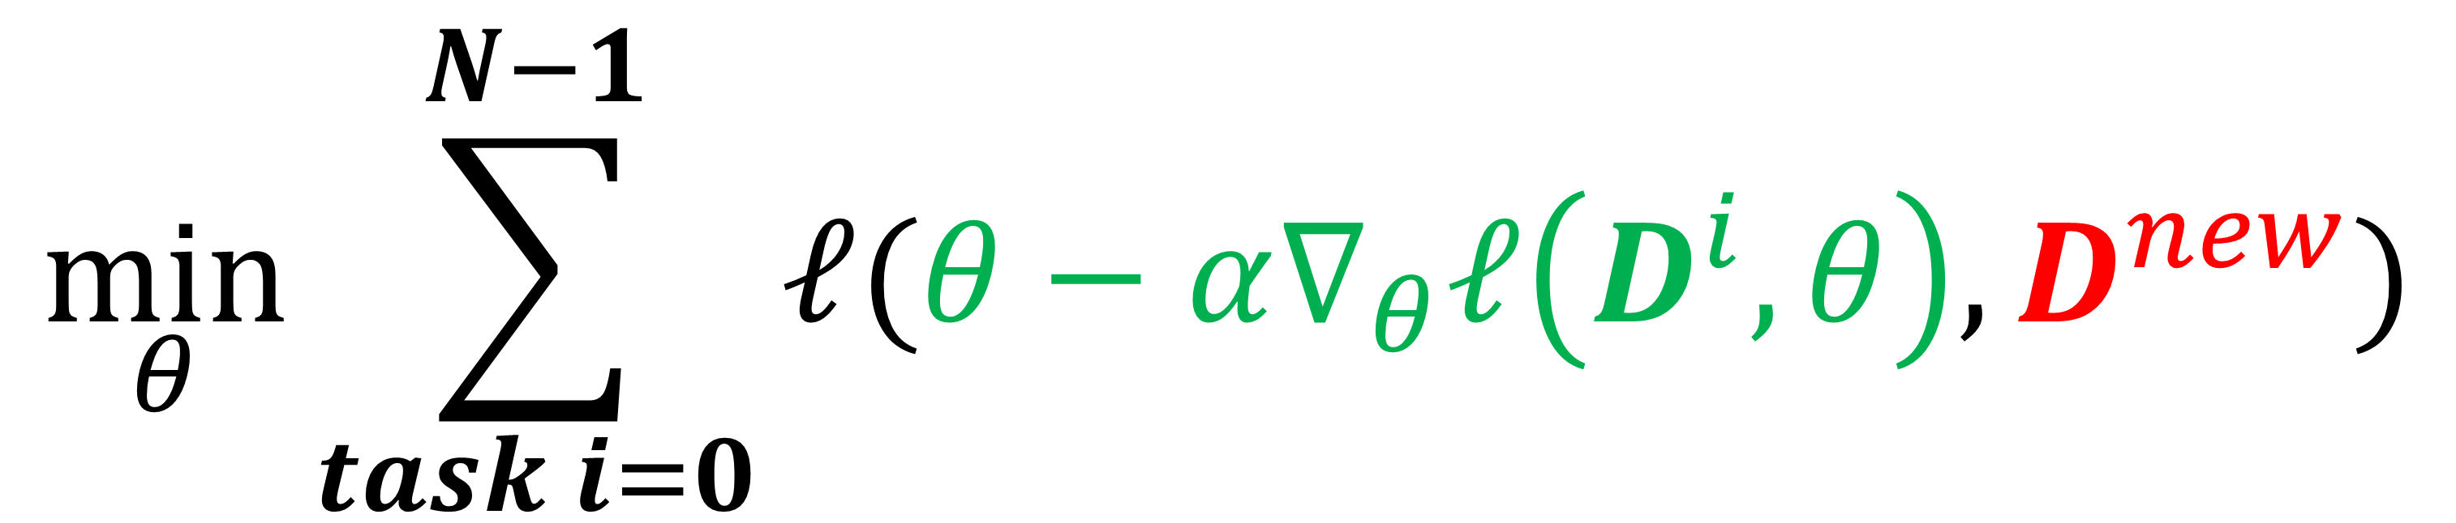
Model Agnostic Meta Learning (MAML)
Define the task as : data set $D$, loss function $ℓ$, model with parameter $f_{θ}$, task $Τ=\{D,ℓ,f_{θ}\}$
Given a set of tasks $T_{i}={\{D,ℓ,f_{θ}\}}_{i}, i=0,…, N−1$, we solve a new task $T^{new}=\left\{D^{new},ℓ,f_{θ}\right\}$ by utilizing the existing tasks
Compute loss of updated model on new task
$$\min_{θ}{\sum_{task i=0}^{N−1}{ℓ(θ−α∇_{θ}ℓ\left(D^{i},θ\right),D^{new})}}$$
Search the optimal model parameter as the one which meets two requirements at the same time:
make progress on the set of tasks
minimize loss on new task
Optimize model parameter on task i
Finn, Abbeel, Levine. Model-Agnostic Meta-Learning. ICML 2017

Slide 18
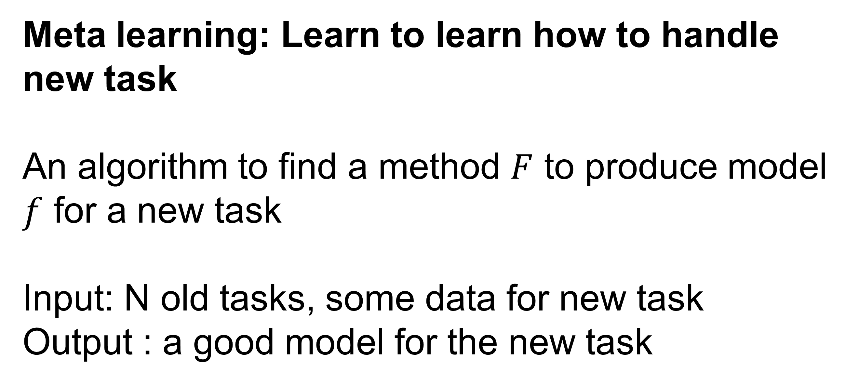
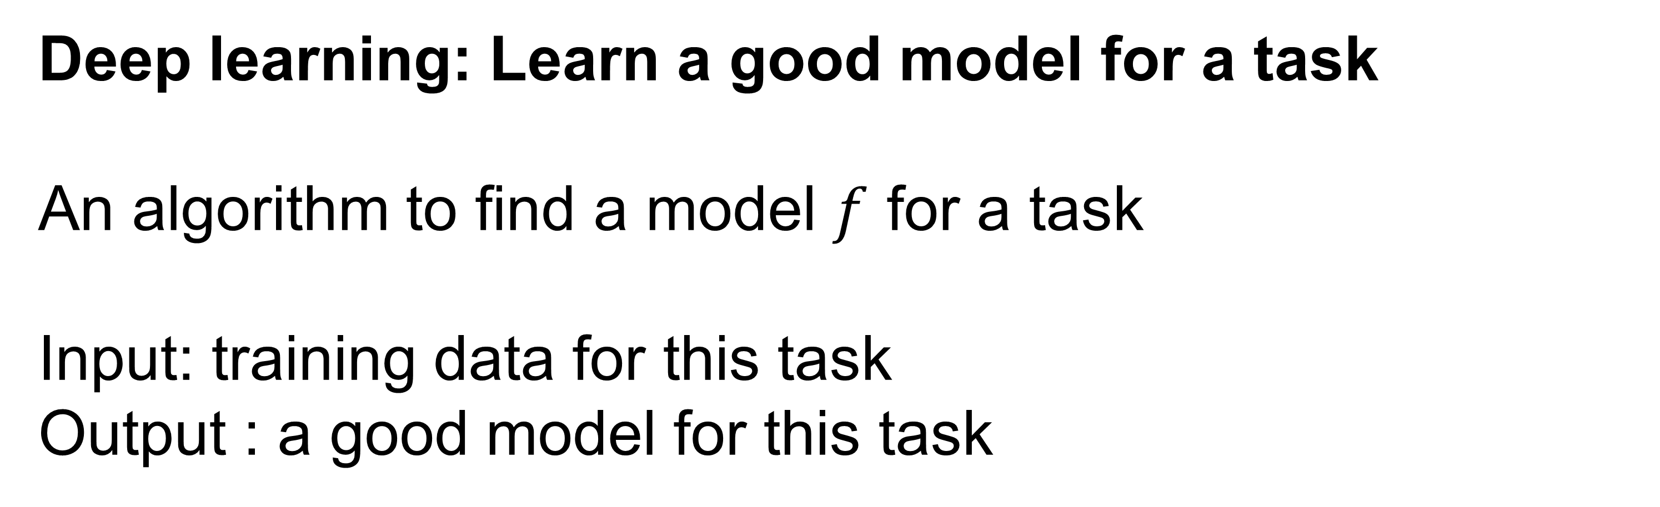
MAML is a type of meta-learning
Meta learning: Learn to learn how to handle new task
An algorithm to find a method $F$ to produce model $f$ for a new task
Input: N old tasks, some data for new task
Output : a good model for the new task
Deep learning: Learn a good model for a task
An algorithm to find a model $f$ for a task
Input: training data for this task
Output : a good model for this task
Training set
Deep learning
A model good for this task
N tasks
A model good for new task
New task
Meta-learning
Can learn other components: learning rate, architecture, data augmentation …
MAML is one of the meta-learning algorithm

Slide 19
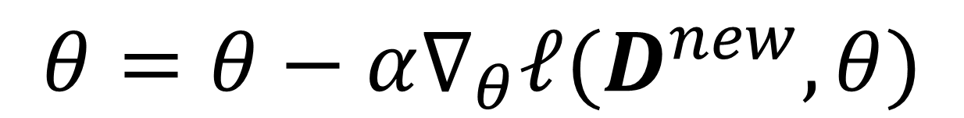
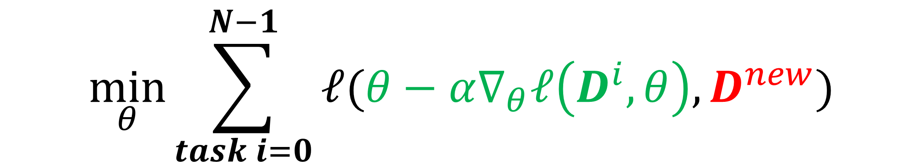
Model Agnostic Meta Learning (MAML)
Define the task as : data set $D$, loss function $ℓ$, model with parameter $f_{θ}$, task $Τ=\{D,ℓ,f_{θ}\}$
Given a set of tasks $T_{i}={\{D,ℓ,f_{θ}\}}_{i}, i=0,…, N−1$, we solve a new task $T^{new}=\left\{D^{new},ℓ,f_{θ}\right\}$ by utilizing the existing tasks
MAML
Fine-tuning
$$\min_{θ}{\sum_{task i=0}^{N−1}{ℓ(θ−α∇_{θ}ℓ\left(D^{i},θ\right),D^{new})}}$$
$$θ=θ−α∇_{θ}ℓ(D^{new},θ)$$
Over a set of related tasks, learn parameters which transfer best to the new task
Inner loop parameter update step
Harder to utilize multiple tasks
Start from a fixing point and optimize for where it can reach; suboptimal
Finn, Abbeel, Levine. Model-Agnostic Meta-Learning. ICML 2017

Slide 20
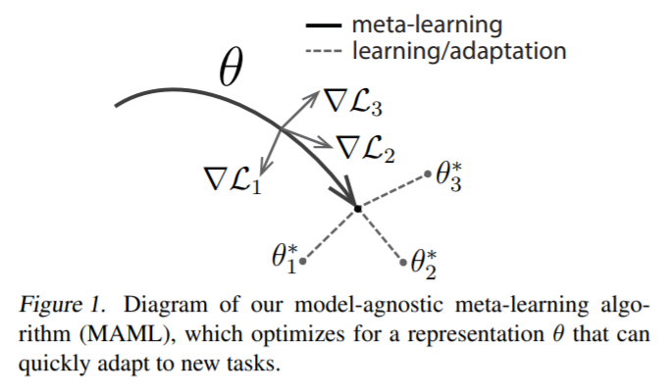
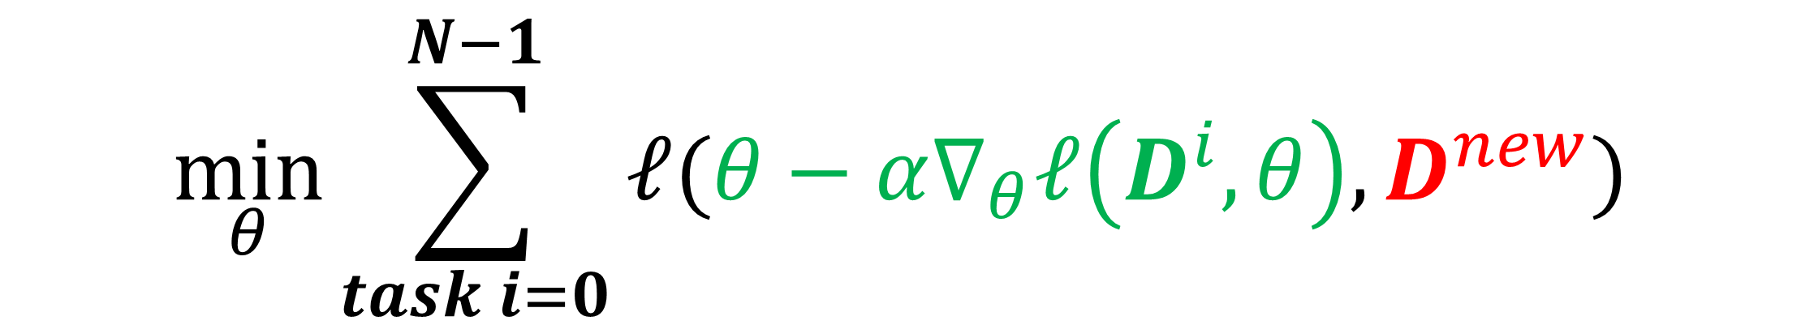
Model Agnostic Meta Learning (MAML)
Define the task as : data set $D$, loss function $ℓ$, model with parameter $f_{θ}$, task $Τ=\{D,ℓ,f_{θ}\}$
Given a set of tasks $T_{i}={\{D,ℓ,f_{θ}\}}_{i}, i=0,…, N−1$, we solve a new task $T^{new}=\left\{D^{new},ℓ,f_{θ}\right\}$ by utilizing the existing tasks
MAML
$$\min_{θ}{\sum_{task i=0}^{N−1}{ℓ(θ−α∇_{θ}ℓ\left(D^{i},θ\right),D^{new})}}$$
Find model parameter quickly adapted to a new task
Also suitable for the few-short learning: give a set of tasks, every task has only K samples
Finn, Abbeel, Levine. Model-Agnostic Meta-Learning. ICML 2017

Slide 21
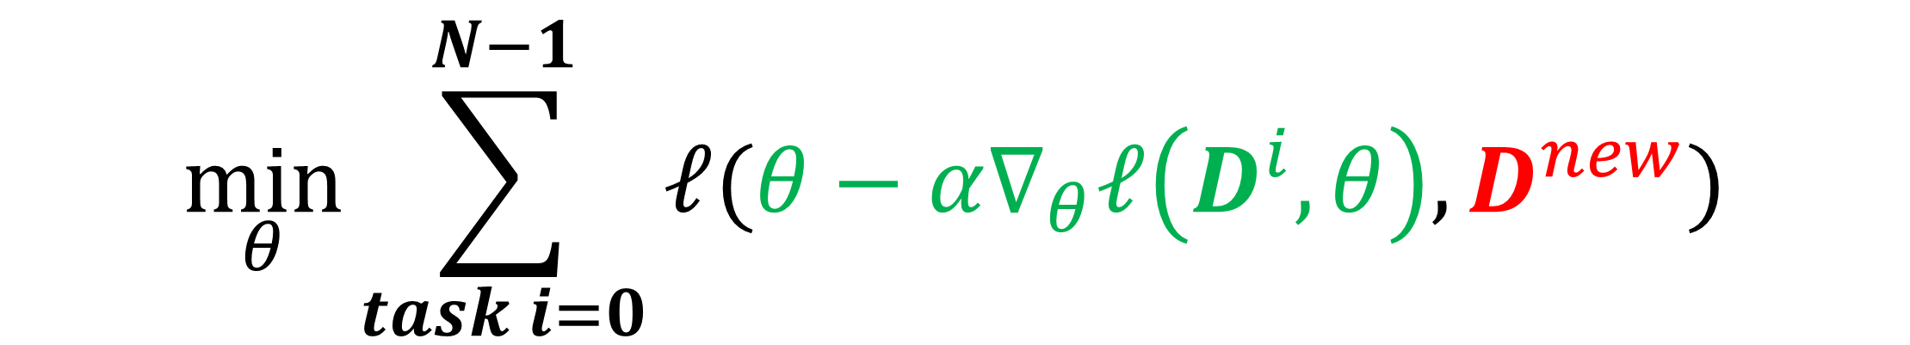
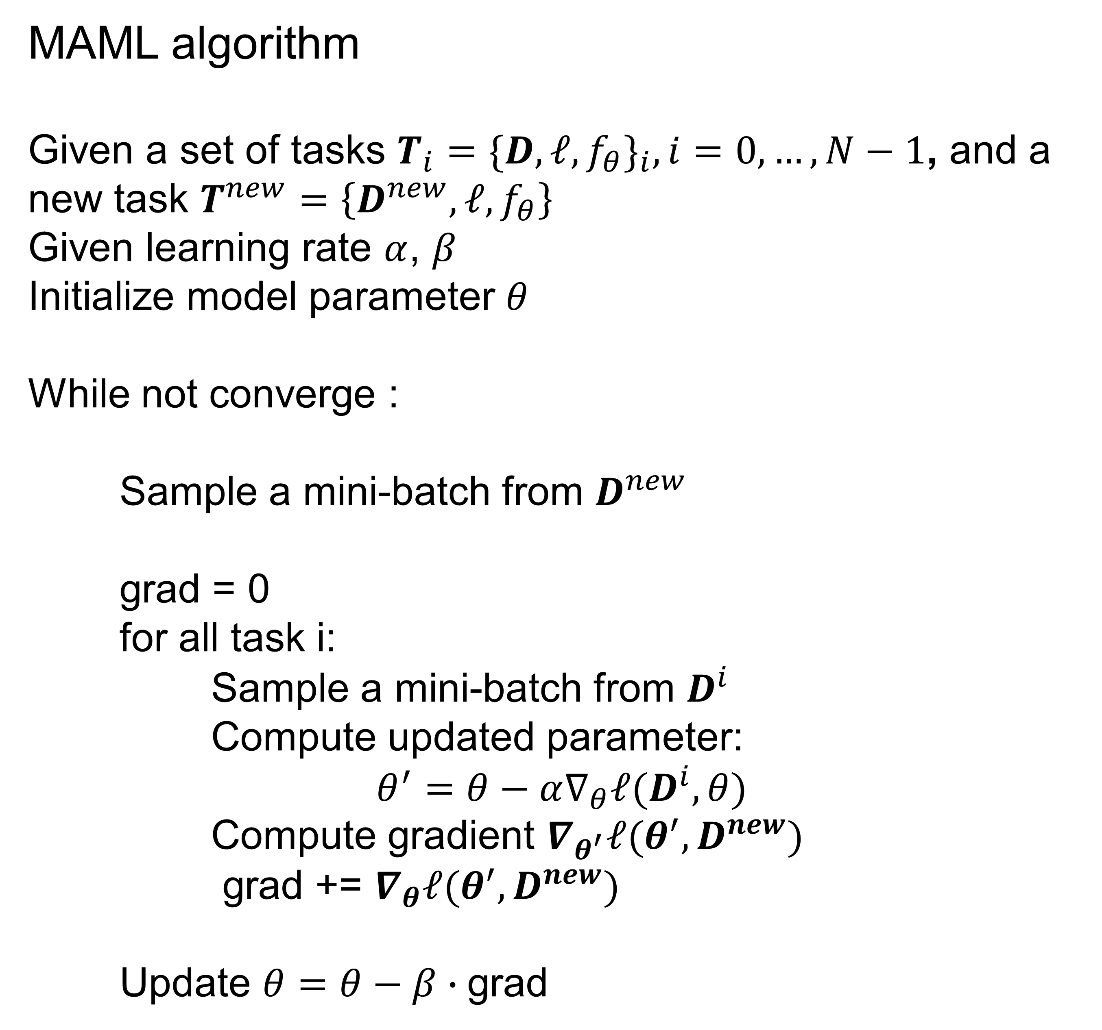
Model Agnostic Meta Learning (MAML)
MAML algorithm
Given a set of tasks $T_{i}={\{D,ℓ,f_{θ}\}}_{i}, i=0,…, N−1$, and a new task $T^{new}=\left\{D^{new},ℓ,f_{θ}\right\}$
Given learning rate $α$, $β$
Initialize model parameter $θ$
While not converge :
Sample a mini-batch from $D^{new}$
grad = 0
for all task i:
Sample a mini-batch from $D^{i}$
Compute updated parameter:
$$θ^{′}=θ−α∇_{θ}ℓ(D^{i},θ)$$
Compute gradient $∇_{θ^{′}}ℓ({θ^{′},D}^{new})$
grad += $∇_{θ}ℓ({θ^{′},D}^{new})$
Update $θ=θ−β∙\text{grad}$
$$\min_{θ}{\sum_{task i=0}^{N−1}{ℓ(θ−α∇_{θ}ℓ\left(D^{i},θ\right),D^{new})}}$$
Inner loop and outer loop optimization
Other optimizers are applicable
Multi-step inner loop is possible
This algorithm is for “old-new task” setup
Finn, Abbeel, Levine. Model-Agnostic Meta-Learning. ICML 2017

Slide 22
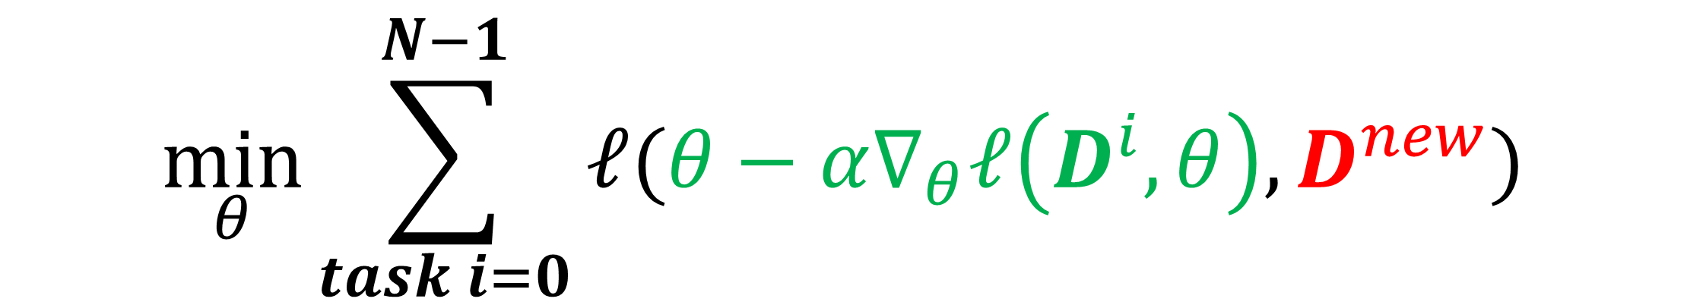
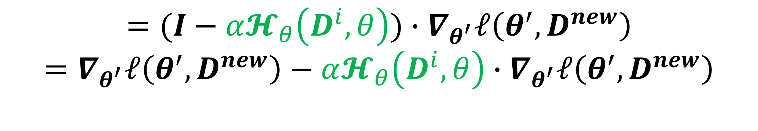
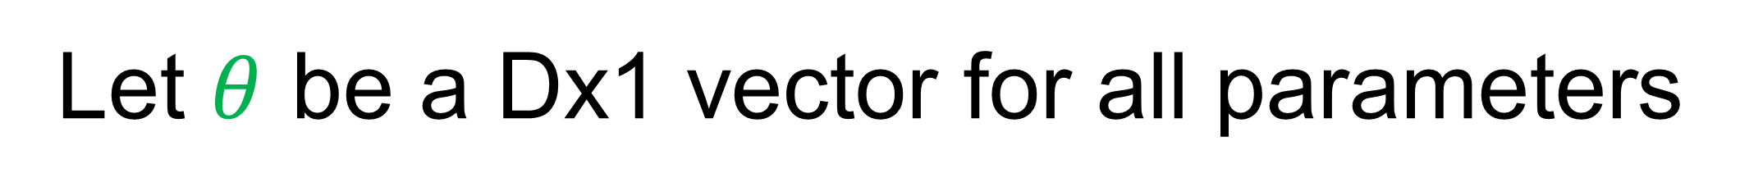
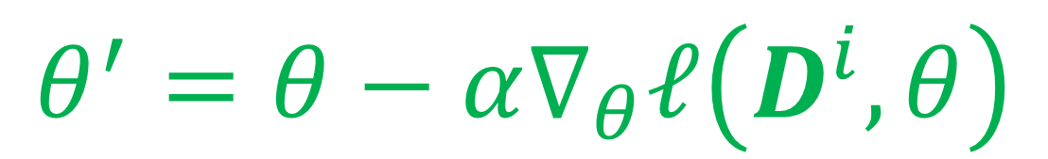
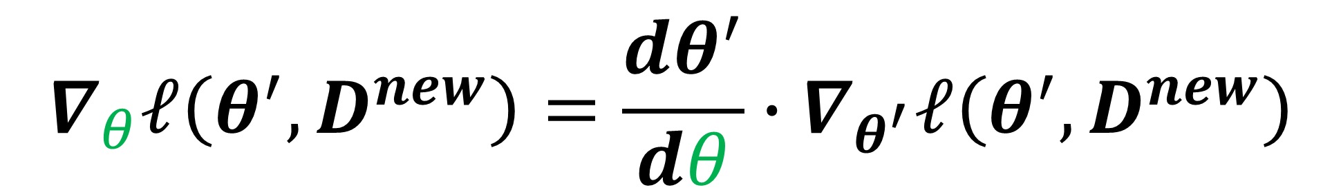
Model Agnostic Meta Learning (MAML)
$$\min_{θ}{\sum_{task i=0}^{N−1}{ℓ(θ−α∇_{θ}ℓ\left(D^{i},θ\right),D^{new})}}$$
$$∇_{θ}ℓ\left({θ^{′},D}^{new}\right)={\frac{dθ^{′}}{dθ}∙∇}_{θ^{′}}ℓ\left({θ^{′},D}^{new}\right)$$
Dx1 vector
$$θ^{′}=θ−α∇_{θ}ℓ\left(D^{i},θ\right)$$
DxD matrix
Let $θ$ be a Dx1 vector for all parameters
$$={(I−α𝓗_{θ}\left(D^{i},θ\right))∙∇}_{θ^{′}}ℓ\left({θ^{′},D}^{new}\right)$$
$$={∇_{θ^{′}}ℓ\left({θ^{′},D}^{new}\right)−α𝓗_{θ}\left(D^{i},θ\right)∙∇}_{θ^{′}}ℓ\left({θ^{′},D}^{new}\right)$$
No need to compute and store full Hessian matrix, but Hessian-vector product

Slide 23

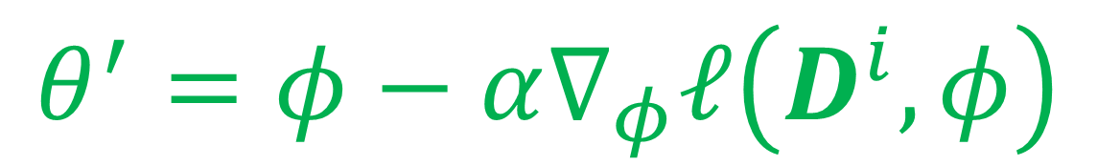

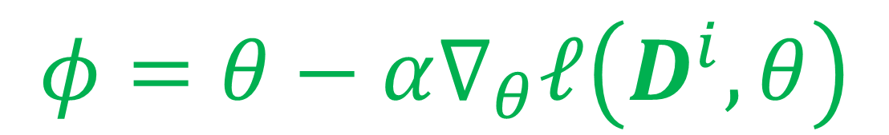
Model Agnostic Meta Learning (MAML)
$$\min_{θ}{\sum_{task i=0}^{N−1}{ℓ(θ−α∇_{θ}ℓ\left(D^{i},θ\right),D^{new})}}$$
Let $θ$ be a Dx1 vector for all parameters
$$∇_{θ}ℓ\left({θ^{′},D}^{new}\right)={\frac{dθ^{′}}{dθ}∙∇}_{θ^{′}}ℓ\left({θ^{′},D}^{new}\right)$$
If we do two inner loop update steps:
$$φ=θ−α∇_{θ}ℓ\left(D^{i},θ\right)$$
Will we get higher order derivatives?
$$θ^{′}=φ−α∇_{φ}ℓ\left(D^{i},φ\right)$$
The answer is no …

Slide 24
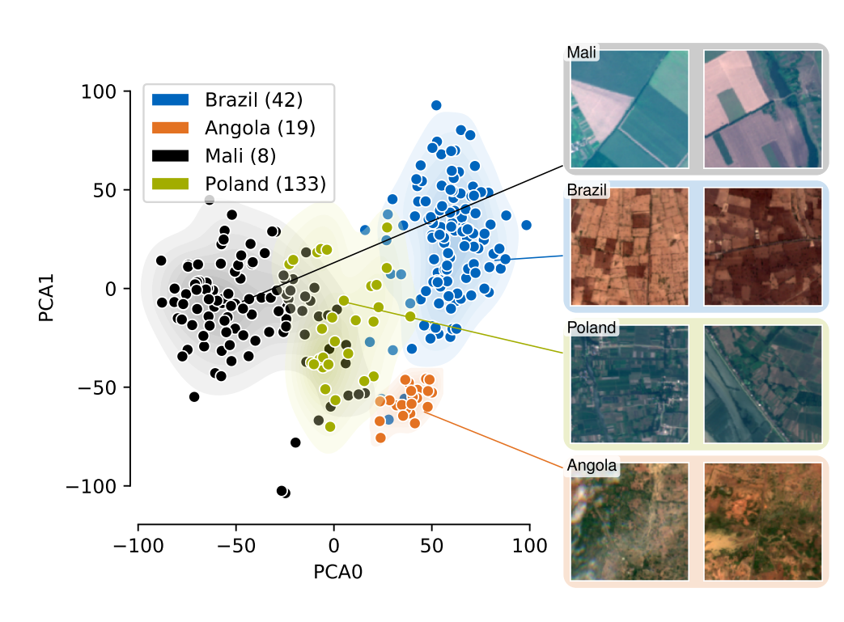
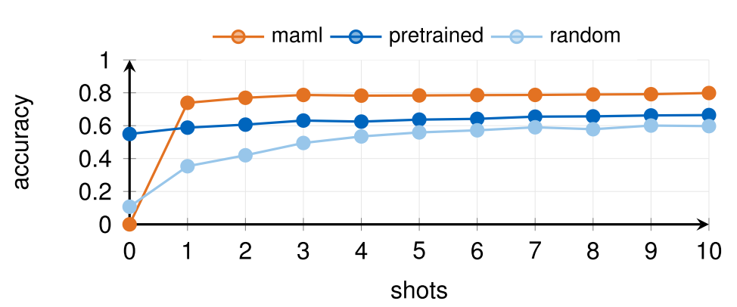
MAML for few-shot learning
Show improved accuracy for few-shot learning tasks, e.g. cropland image classification from different countries.
125 regions, 4 seasons each region
Few-shot learning setup
Meta-Learning for Few-Shot Land Cover Classification. 2020. https://arxiv.org/abs/2004.13390

Slide 25

MAML for old-new tasks
Old task with a lot of labelled data
Often called “support”
New task with a few labelled data
Often called “query”
Using existing labelled data to help new tasks
Can meta-learning help speedup development ? To break barrier between:
patient cohort
anatomy/imaging
disease
hospitals/countries
… …
Myocardium
Aorta
Anatomy
Train set:
2,581 cine images
120 aorta images
Query set
200 aorta images
Test set
100 new images

Slide 26



MAML for old-new tasks
MAML
Dice mean: 0.95
Test cases
Supervised Learning
Dice mean: 0.88

Slide 27

Further developments
Development | What is for
First-order MAML https://arxiv.org/abs/1803.02999 | Only keep the first term $$∇_{θ}ℓ\left({θ^{′},D}^{new}\right)≈∇_{θ^{′}}ℓ\left({θ^{′},D}^{new}\right)$$
Implicit MAML https://arxiv.org/abs/1909.04630 | Derive meta-gradient using the implicit function theorem; reduce memory footprint
AlphaMAML https://arxiv.org/abs/1905.07435 | Automated tune the inner learning rate
MAML++ https://arxiv.org/abs/1810.09502 | Improve the generalization performance, convergence speed and computational overhead
Reptile https://arxiv.org/abs/1803.02999 | Simplified first-order method with faster updates
ANIL https://arxiv.org/abs/1909.09157 | A simplification of MAML where we remove the inner loop for all but the (task-specific) head of a MAML-trained network

Slide 28




Open-source libraries
for all task i:
Sample a mini-batch from $D^{i}$
Compute updated parameter:
$$θ^{′}=θ−α∇_{θ}ℓ(D^{i},θ)$$
Compute gradient $∇_{θ^{′}}ℓ({θ^{′},D}^{new})$
grad += $∇_{θ}ℓ({θ^{′},D}^{new})$
Require to extract and reset model parameters
Pytorch model often contains its parameter in layers
Inconvenient to apply MAML on existing models
higher is a library providing support for higher-order optimization, e.g. through unrolled first-order optimization loops, of "meta" aspects of these loops.
https://github.com/facebookresearch/higher

Slide 29
Outline
Transfer learning
Meta Learning
Contrastive learning

Slide 30


Self-supervised learning
Classes: 21841 Images: 14,197,122
It is impossible to label even a small portion of available data …
Data distribution has long tail
https://atcold.github.io/pytorch-Deep-Learning/en/week10/10-1/
https://datascience.stackexchange.com/questions/11777/what-is-the-distribution-of-categories-in-imagenet-training-set-ilsvrc2012

Slide 31

Self-supervised learning
Much harder to establish labels requiring domain expertise
Total data available:
Number of Perfusion scans is 57316,
from 20160225 to 20210519
Labelled data available:
1825 perfusion series from 1034 patients
1.8%

Slide 32

Self-supervised learning
*Self-supervised learning obtains supervisory signals from the data itself, often leveraging the underlying structure in the data.
Often set up as a training task to predict unobserved or hidden part of the input from any observed or unhidden part of the input.
Aim to learn the representation/”common sense” from large amount of unlabeled data to boost performance of downstream tasks (e.g. classification, detection etc.)
Predict future sentences given the prompt
Predict masked works
Predict next video frame
* https://ai.facebook.com/blog/self-supervised-learning-the-dark-matter-of-intelligence
https://t.co/BZZgcTW4jO?amp=1

Slide 33

“Pretext” set up for SSL
Pretext tasks aim to learn data representation with self-established “labels” without human inputs
Learned data representation is used to help downstream tasks e.g. object segmentation, abnormality detection, …
Backbone
model
representation vectors from different layers of backbone model
Self-supervisory signal
Pretext

Slide 34
“Pretext” set up for SSL
Pretext tasks aim to learn data representation with self-established “labels” without human inputs
Learned data representation is used to help downstream tasks e.g. object segmentation, abnormality detection, …
representation vectors
Downstream task model
Freeze
the weights
Task specific
model
Backbone
model
Task specific data, supervised
Task specific output
Train this part
Or, fine tune the entire network; Or, run MAML; …

Slide 35


Pretext as the random rotation
Unsupervised Representation Learning by Predicting Image Rotations. 2018. https://arxiv.org/abs/1803.07728

Slide 36


Pretext as the random rotation
Unsupervised Representation Learning by Predicting Image Rotations. 2018. https://arxiv.org/abs/1803.07728

Slide 37

Pretext as the Jigsaw Puzzle game
Randomly pick from one pre-defined permutation
Unsupervised Learning of Visual Representations by Solving Jigsaw Puzzles. https://arxiv.org/abs/1603.09246

Slide 38

Pretext as the inpainting
Fill in the masked portion in the image
Context Encoders: Feature Learning by Inpainting. https://arxiv.org/pdf/1604.07379.pdf

Slide 39


Pretext as the coloring task
Trained on 1.3M ImageNet images
Colorful Image Colorization. https://arxiv.org/abs/1603.08511
Split-Brain Autoencoders: Unsupervised Learning by Cross-Channel Prediction. https://arxiv.org/abs/1611.09842
http://richzhang.github.io/colorization/
https://demos.algorithmia.com/colorize-photos

Slide 40



SSL as pretexts
Pros
Able to generate self-supervisory signal
Able to use large amount of unlabeled data
Cons
Still have “feature engineering” to select pretext tasks
Need careful design the interaction between backbone and task-specific components
Does not conduct optimization in the representation space, but in “task” space

Slide 41









SSL as contrastive learning
Define a general framework to optimize in the representation space
The goal of optimization is :
Given a reference sample $x$,
for its positive neighbors $x^{+}$, reduce its distance to reference in representation space
for its negative neighbors $x^{−}$, increase its distance to reference in representation space
$$x^{+}$$
$$x^{+}$$
$$x^{+}$$
pull
push
$$x$$
$$x^{−}$$

Slide 42



SSL as contrastive learning
Define a general framework to optimize in the representation space
The goal of optimization is :
Given a reference sample $x$,
for its positive neighbors $x^{+}$, reduce its distance to reference in representation space
for its negative neighbors $x^{−}$, increase its distance to reference in representation space
After learning
$$x^{+}$$
$$x^{+}$$
$$x^{+}$$
$$x$$
$$x^{−}$$

Slide 43








Contrastive learning
$$score\left(f\left(x\right),f(x^{+})\right)≫score(f\left(x\right),f(x^{−}))$$
reference sample $x$
positive sample $x^{+}$,
negative sample $x^{−}$
$score$ is a function measure the distance between the learned representation between the reference and positive/negative samples
$f$ is the encoding model to be learned from data
$g$ is called the projection header
converting representation to the space for loss computation
Empirically improve performance
Mimic downstream task
$$x^{+}$$
$$x^{−}$$
SimCLR
A Simple Framework for Contrastive Learning of Visual Representations. https://arxiv.org/abs/2002.05709
Big Self-Supervised Models are Strong Semi-Supervised Learners. 2020. https://arxiv.org/abs/2006.10029

Slide 44


Contrastive learning
Score function
Common choices: L2, L1, cosine …
https://towardsdatascience.com/understanding-cosine-similarity-and-its-application-fd42f585296a

Slide 45

Contrastive learning
InfoNCE loss
Give the reference sample, a positive sample and a set of negative sample
Nothing more than the cross-entropy loss
softmax over all scores between ref and positive/negative samples
Normalized to become probability
Representation Learning with Contrastive Predictive Coding. https://arxiv.org/abs/1807.03748

Slide 46

Contrastive learning
Define a set of data augmentation transformation
Randomly sample from data augmentations and create positive samples
A Simple Framework for Contrastive Learning of Visual Representations. https://arxiv.org/abs/2002.05709
Big Self-Supervised Models are Strong Semi-Supervised Learners. 2020. https://arxiv.org/abs/2006.10029

Slide 47

Contrastive learning
SimCLR
The training enforces the positive pairs to be close and the negative pairs to be far away in representation space
MLP project head is partly due to the CE type loss used in the framework – often, the classification problem is easier to train than e.g. L2 norm
Once the model is trained with large amount of data, it can learn a compact and effective representation for downstream tasks (a good encoder)
https://ai.googleblog.com/2020/04/advancing-self-supervised-and-semi.html
A Simple Framework for Contrastive Learning of Visual Representations. https://arxiv.org/abs/2002.05709
Big Self-Supervised Models are Strong Semi-Supervised Learners. 2020. https://arxiv.org/abs/2006.10029

Slide 48



Contrastive learning
SimCLR
$Τ$ is a set of data augmentation
For every sample in the minibatch, apply the data augmentation to create two positive samples
Compute score between all generated samples
Compute InfoNCE loss
For the kth sample in mini-batch, 2k-1 and 2k are positive pair. 2k-1 and others are negative pairs
$τ$ is the temperature parameter, boosting generalization performance
A Simple Framework for Contrastive Learning of Visual Representations. 2020. https://arxiv.org/abs/2002.05709
Big Self-Supervised Models are Strong Semi-Supervised Learners. 2020. https://arxiv.org/abs/2006.10029

Slide 49










Contrastive learning
SimCLR
A mini-batch with three samples : $x_{1}$, $x_{2}$, $x_{3}$
$$x_{1}$$
$$x_{2}$$
$$x_{3}$$
negative
negative
negative
$$z_{1}$$
positive
$$z_{2}$$
$$z_{3}$$
$$z_{4}$$
$$z_{5}$$
$$z_{6}$$
negative
$$ℒ=\frac{1}{6}[ℓ\left(1,2\right)+ℓ\left(2,1\right)+ℓ\left(3,4\right)+ℓ\left(4,3\right)+ℓ\left(5,6\right)+ℓ\left(6,5\right)]$$
$$ℓ\left(1,2\right)=−log\frac{exp⁡(s(z_{1},z_{2}))}{exp⁡(s\left(z_{1},z_{2}\right))+exp⁡(s\left(z_{1},z_{3})\right)+exp⁡(s\left(z_{1},z_{4})\right)+exp⁡(s\left(z_{1},z_{5})\right)+exp⁡(s\left(z_{1},z_{6})\right)}$$
$$ℓ\left(2,1\right)=−log\frac{exp⁡(s(z_{2},z_{1}))}{exp⁡(s\left(z_{2},z_{1}\right))+exp⁡(s\left(z_{2},z_{3})\right)+exp⁡(s\left(z_{2},z_{4})\right)+exp⁡(s\left(z_{2},z_{5})\right)+exp⁡(s\left(z_{2},z_{6})\right)}$$
Count positive and negative pairs correctly
A Simple Framework for Contrastive Learning of Visual Representations. https://arxiv.org/abs/2002.05709
Big Self-Supervised Models are Strong Semi-Supervised Learners. 2020. https://arxiv.org/abs/2006.10029

Slide 50

Contrastive learning
Fine-tune for task specific data
Train task specific layers
Or, fine tuning
Or, Meta-Learning
Downstream
task layers
Task specific loss
Task specific labelled data
A Simple Framework for Contrastive Learning of Visual Representations. https://arxiv.org/abs/2002.05709
Big Self-Supervised Models are Strong Semi-Supervised Learners. 2020. https://arxiv.org/abs/2006.10029
https://amitness.com/2020/03/illustrated-simclr/

Slide 51

Contrastive learning
Very good data efficiency
First train SSL model on the ImageNet dataset
Further fine-tune a linear MLP with a fraction of labelled data
Having the projection header boosts the performance of a linear classifier trained on the SimCLR-learned representation by more than 10%
For 1% of labelled data, 76.5% / 93.2% top-1 / top-5 accuracy on ImageNet
A Simple Framework for Contrastive Learning of Visual Representations. https://arxiv.org/abs/2002.05709
Big Self-Supervised Models are Strong Semi-Supervised Learners. 2020. https://arxiv.org/abs/2006.10029

Slide 52

Contrastive learning
Performance is limited by the batch size for the number of available negative samples
In the SimCLR, large batch size is required
Original paper used Google Large TPU for training – not available for others
“With 128 TPU v3 cores, it takes ∼1.5 hours to train our ResNet-50 with a batch size of 4096 for 100 epochs.”
Further improved by algorithms like Momentum Contrastive Learning (MoCo and MoCo v2, 2020, https://arxiv.org/abs/2003.04297)
A Simple Framework for Contrastive Learning of Visual Representations. https://arxiv.org/abs/2002.05709
Big Self-Supervised Models are Strong Semi-Supervised Learners. 2020. https://arxiv.org/abs/2006.10029

Slide 53





Momentum Contrastive learning (MoCo)
Momentum Contrast for Unsupervised Visual Representation Learning
Solve the problem of large batch size in SimCLR
Keep a buffer of negative samples ($x_{i}^{key})$
Update encoder for every mini-batch using gradient
Update momentum encoder using momentum of encoder
since backprop is not used to update momentum encoder (buffer should be large in size)
Roll out negative samples by adding mini-batch into keys
Update with gradient
Update with momentum
$$θ_{q}$$
$$θ_{k}$$
https://github.com/facebookresearch/moco
Momentum Contrast for Unsupervised Visual Representation Learning. 2020. https://arxiv.org/abs/1911.05722
Big Self-Supervised Models are Strong Semi-Supervised Learners. 2020. https://arxiv.org/abs/2006.10029

Slide 54








Contrastive learning as a new tool
Large data collection for tasks
Model deployment with less labels
$$x^{−}$$
Task specific labelled data
Downstream
task layers
Task specific loss
$$x^{+}$$
MobileNet v2: https://ai.googleblog.com/2018/04/mobilenetv2-next-generation-of-on.html
Contrastive learning
with
Baseline models for different tasks
Task specific training

